Slide 1
Cybersecurity Risk Management Framework
Design for a high-level cybersecurity risk management framework

Slide 2
Risk management framework
Risk management: Identifying and managing any potential risks. The threat to an organization may come from the inside or from the outside and the risks management allows organizations to qualify those risks

Slide 3
Risk identification
Defacement of uncertainty
Risk management helps to understand potential and emerging risks
A threat hunt for weaknesses before it gets out of control
Growth of the organization = Bigger risks
Refusal to succumb to risks
Internal threats vs. External threats

Slide 4
Approach 1: Threat Modeling
Description: A proactive process for identifying potential threats, examine their potential attack vectors, and determining how they could impact a system before an attack occurs.
Thoroughness: This method is highly profound in understanding what could go wrong, who might attack, and how to defend against the threat actor.
Practicality: Practically, it is used during the phase of design or early in the system lifecycle
Key steps:
Asset identification > (Systems, data, processes)
Threat Identification > (Insiders, hackers, malwares)
Attack Surface recognition > (APIs, entry points, network exposure)
Threat prioritization > (Risk)

Slide 5
Approach 2: Vulnerability Assessment
2nd Approach Vulnerability Assessment
Description: Vulnerability assessments are a reactive and operational process that scans and evaluates systems for known weaknesses that could be exploited by threats.
Goal > Vulnerability exposure and Attack surface Reduction. It used after deployment or an ongoing basis
Scan system > Nessus or OPenVAS
Vulnerabilities Identification (Outdated software, misconfigurations)
Severity assignment through CVSS > Common Vulnerable Scoring System or risk rating
Remediation recommendation (Patch, harden, reconfigure)

Slide 6
Comparison: Threat Modeling vs. Vulnerability Assessments
Aspect | Threat Modeling | Vulnerability Assessments
Thoroughness | Excellent for design and logical flaws. | Excellent for known technical flaws.
Proactiveness | Proactive; done during design and development. | Reactive; finds existing vulnerabilities.
Risk Vectors | Covers a wide range (insider, external, human error). | Primarily covers technical, known threats.
Resource | Requires deep technical and architectural expertise. | Primarily requires automated tools and analysis.

Slide 7
Risk Assessment Criteria and Prioritization

Slide 8
Risk Assessment Criteria
Description: Risk assessment is all about determining which risks matter most and how to deal with them.
Assessment Criteria
Likelihood (Probability)
Scales often used:
Qualitative: Low / Medium / High
Quantitative: 0-1 or 1-5 scale (e.g. 1= rare, 5 0 almost certain)
Financial Impact: Potential monetary loss.
Reputational Damage: Damage to the company's reputation and customer trust.
Operational Disruption: Impact on business continuity and service delivery

Slide 9
Prioritization Method 1: Risk Matrix (Qualitative Analysis)
Description: This is a visual tool that plots risks on a matrix with Likelihood on one axis and Impact on the other. This creates zones of high, medium, and low risk, providing a simple way to prioritize.
Effectiveness: Highly effective for quick, high-level prioritization and communication. It visually highlights the most critical risks, making it easy for both technical and non-technical stakeholders to understand.
Usability: It's intuitive and easy to use. Decision-making is simplified because risks in the "High-High" zone are clearly the top priority for treatment.

Slide 10
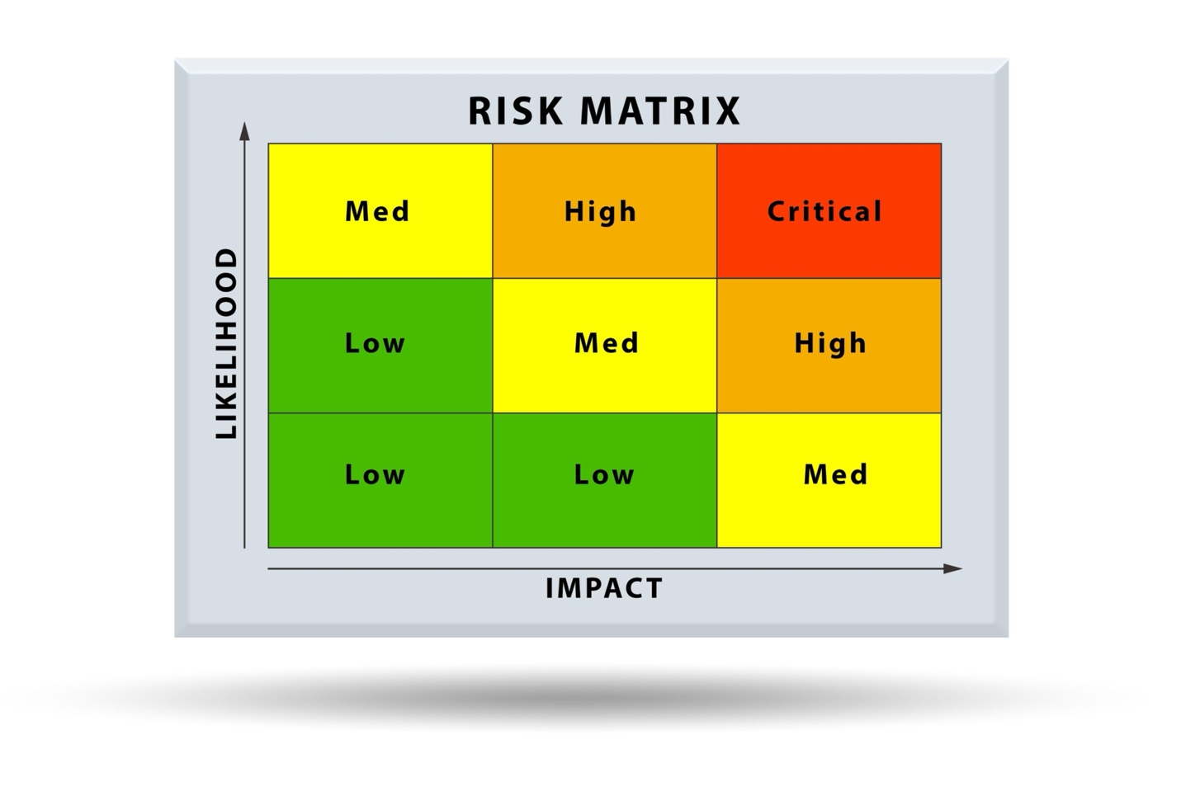

Slide 11
Risk Treatment Options
After risks are assessed and prioritized, a treatment strategy must be chosen.

Slide 12
Risk Option 1: Risk Transfer
Core function
Shift the risk under the raider of another Party
Purchase Cybersecurity insurance
Cost & Practicality
Of course, the purchase does not come without cost
Effectiveness:
Financial Recovery leverage
Safety net
Side Effect?
False Sense of Security

Slide 13
Risk Option 2: Risk Mitigation
Core function
Risk level Reduction: This involves the implementation of security controls, or you invest in security system
Example:
Firewall Deployment for tight security purpose > (NGFW) & UTM to block a malicious network traffic
Cost & Practicality
The cost varies widely depending on the control (e.g., purchasing a new firewall vs. enabling MFA).

Slide 14
Risk Option 2: Risk Mitigation
Continue
Long-Term Effectiveness:
Highly effective
Mitigative controls address the root cause of the risk and provide a long-term solution by hardening the environment against threats.
Potential Side Effects
Impact on operational efficiency (e.g., a strict firewall rule might block a legitimate service) OR
User inconvenience (e.g., MFA adds a step to the login process)
At the end of the day, authentication matters.

Slide 15
Comparison: Threat Modeling vs. Vulnerability Assessments
Aspect | Risk Mitigation | Risk Transfer
Purpose | Reduces the likelihood or impact of a risk. | Shifts the financial consequence of a risk.
Cost | Varies; can be high or low depending on the control. | Insurance premium.
Long-term | Proactive and provides a long-term security solution. | Reactive; provides financial recovery but no prevention.
Side Effects | Can impact operations or user experience. | Can lead to a false sense of security.
Aspect | Risk Mitigation | Risk Transfer

Slide 16
Risk Acceptance Criteria
Risk Acceptance
A business decision: Accept the risks that are detected
Acceptance Criteria:
Residual Risk: The remaining risk after mitigation efforts have been implemented
Accept with Exemptions:
>A security policy or regulation cannot be followed
>Exemptions may need an approval

Slide 17
Risk Acceptance Criteria:
Continuity
Cost-Benefit Analysis: The cost of further mitigation efforts is greater than the potential impact of the risk.
Business Impact:
The risk with minimal impact on operations, reputation, or finances, and
The organization is prepared for a potential loss.

Slide 18
Documentation and Monitoring Process
Documentation:
A central risk register or database for documentation all accepted risks.
A unique risk ID
Description of the risk.
Original Likelihood and Impact scores.
Justification for accepting the risk (referencing the criteria above).
Sign-off from the risk owner and relevant management.

Slide 19
Monitoring
Periodic review (e.g., quarterly or annually) to ensure that the initial assumptions are still valid.
Changes in threat landscape, new vulnerabilities, or changes in the business environment may require re-evaluation.

Slide 20
Ongoing Monitoring and Risk Management
Cybersecurity risk management is an ongoing process, not a one-time event.
Two key approaches that ensure continuous monitoring can be adopted:

Slide 21
Approach 1: Automated Monitoring Tools
Technology for continuous scanning of the network and systems
SIEM (Security Information and Event Management): Aggregation and analysis of loss from various sources
IDS (Intrusion Detection System): Monitoring of network traffic and alert
IPS (Intrusion Prevention System): Monitoring of network traffic and response to potential suspicious activities on the network

Slide 22
Approach 1: Automated Monitoring Tools: Continuity
Effectiveness:
Provision of real-time detection of threats, vulnerabilities, and policy violations to mitigate emerging risks.
Resource Requirements:
A significant upfront investment in technology is required
skilled personnel to configure, manage, and respond to alerts.

Slide 23
Approach 2: Periodic Assessments and Audits
Description: This involves a scheduled and orchestrated in-depth reviews of the organization’s security posture.
Example: Penetration testing, internal policy reviews or third-party security audits
Effectiveness: Highly effective for in-depth analysis of the security posture.
Discovery of complex vulnerabilities and control weaknesses that automated tools might miss.
Compliance with regulations and internal policies.

Slide 24
Periodic Assessments and Audits: continuity
Resource Requirements
Manual usage
Costly and disruptive resource-intensive efforts
No continuity and only provide a snapshot in time.

Slide 25
Comparison: Threat Modeling vs. Vulnerability Assessments
Aspect | Automated Monitoring | Periodic Assessments
Effectiveness | Real-time threat detection and continuous visibility. | In-depth analysis and validation of controls.
Resource | High initial cost, but efficient for ongoing use. | High cost and manual effort for each engagement.
Nature | Continuous and passive. | Scheduled and active (point-in-time).
Aspect | Automated Monitoring | Periodic Assessments
Effectiveness | Real-time threat detection and continuous visibility. | In-depth analysis and validation of controls.

Slide 26
Conclusion
Mid-Size company should use both approaches. Why?
Automated monitoring provides the continuous, day-to-day vigilance
Periodic assessments and audits offer a crucial "reality check" to validate controls

Slide 27
Thanks for listening
Any question?

